Slide 1
Transition and Animation

Slide 2
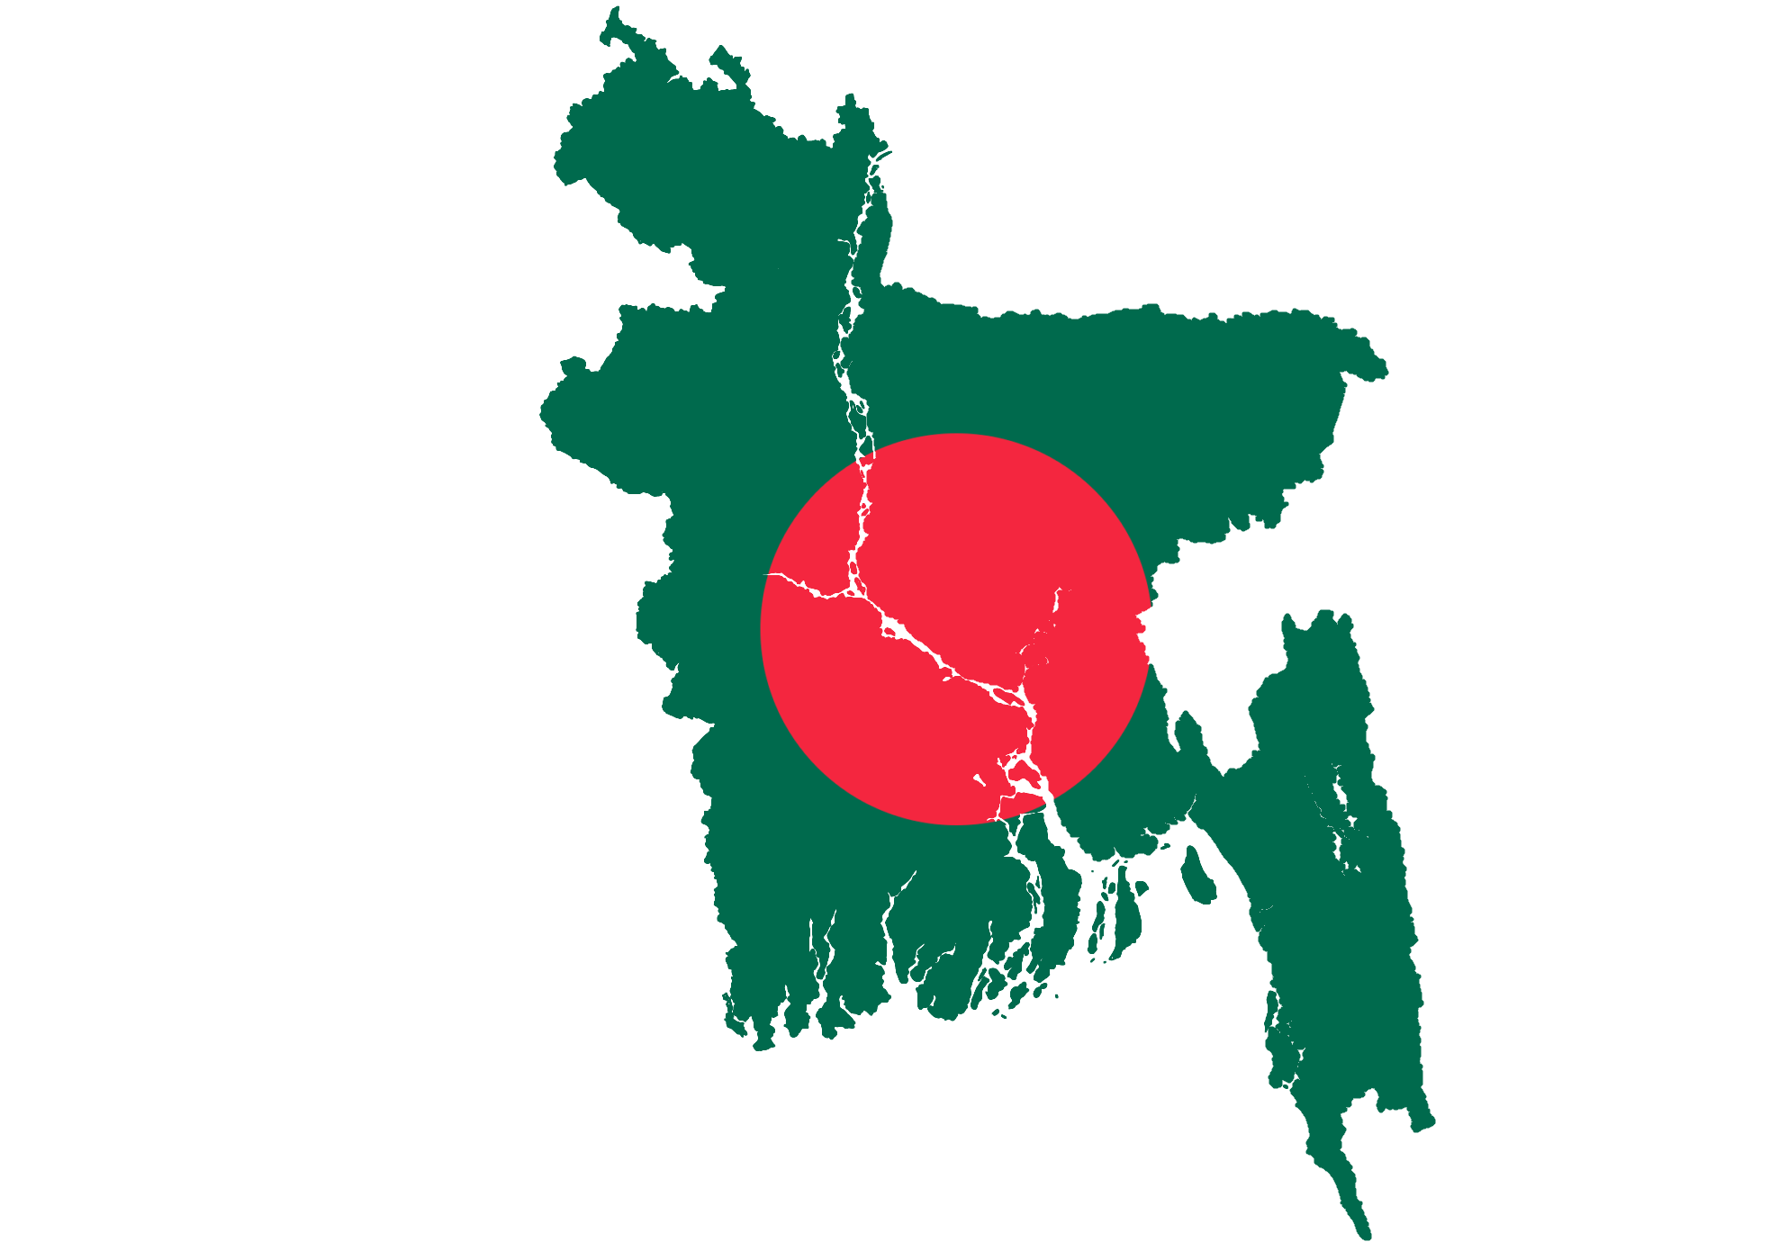
Bangladesh
Bangladesh is a country in South Asia.

Slide 3
Bangladesh
It is the eighth-most populous country in the world and seventh most densely populated with a population of 180 Millions.

Slide 4
Bangladesh
The country came into existence in 1971 after declaring independence from Pakistan at the start of Bangladesh Liberation War.

Slide 5
Bangladesh
The term Bangla is a major name for both the Bengal region and the Bengali language.

Slide 6
Bangladesh
Bangladesh is in South Asia on the Bay of Bengal. It is surrounded almost entirely by neighbouring India, and shares a small border with Myanmar to its southeast, though it lies very close to Nepal, Bhutan, and China.

Slide 7
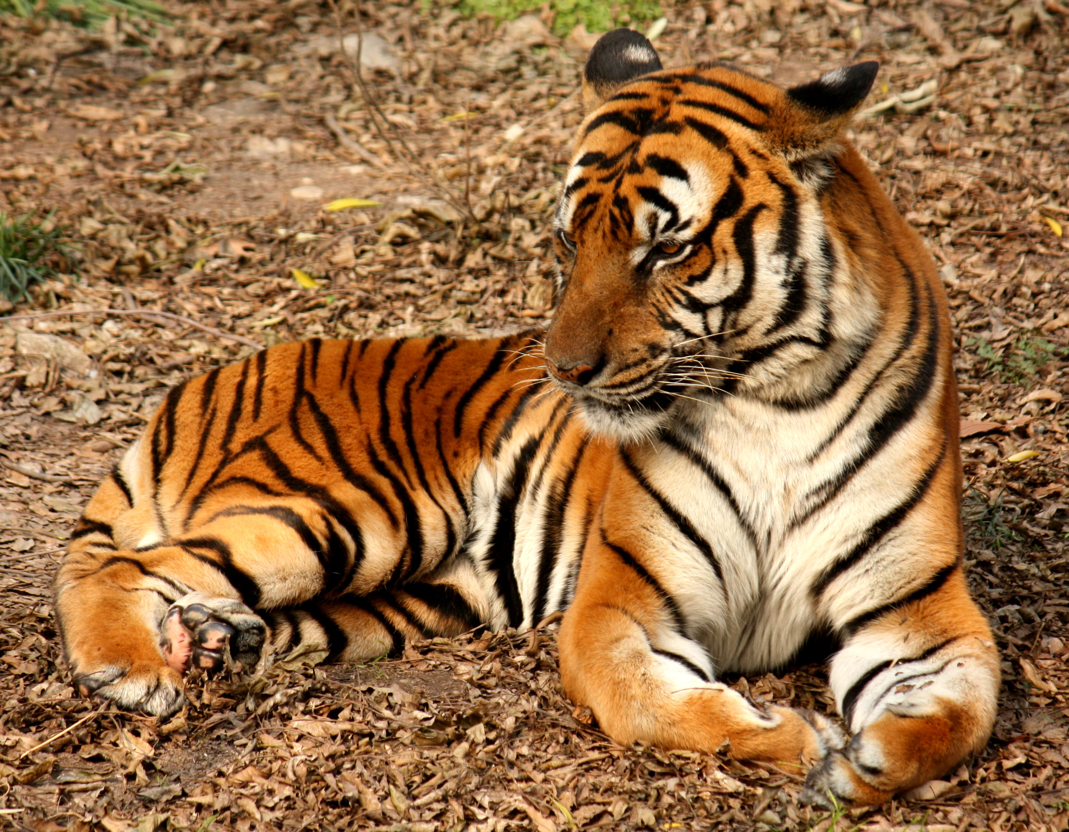
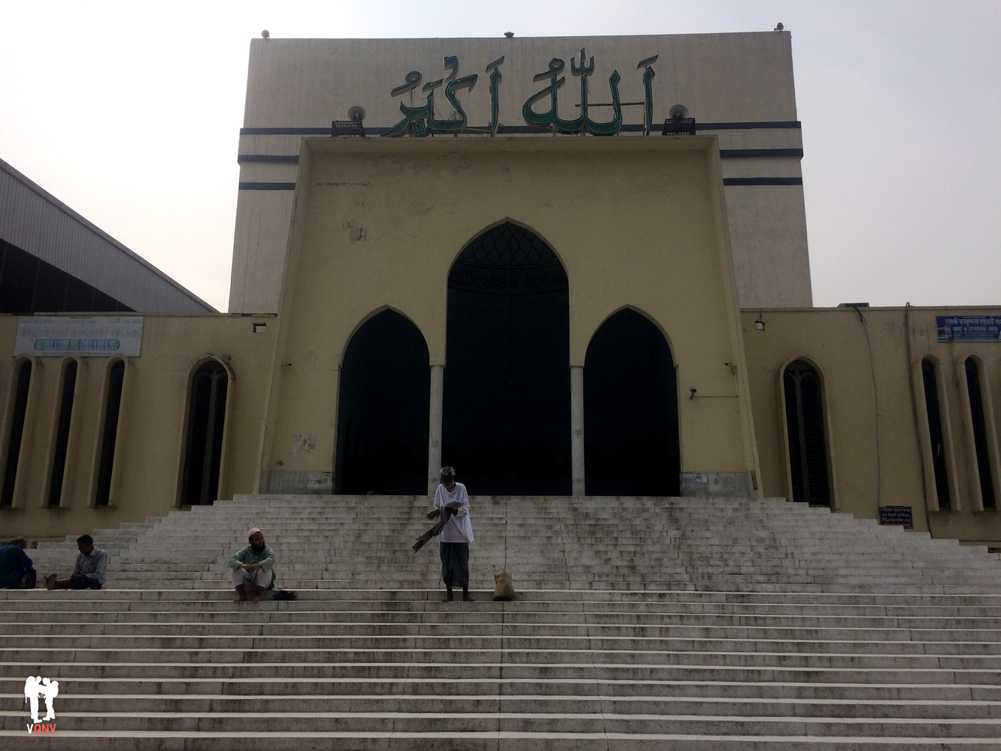

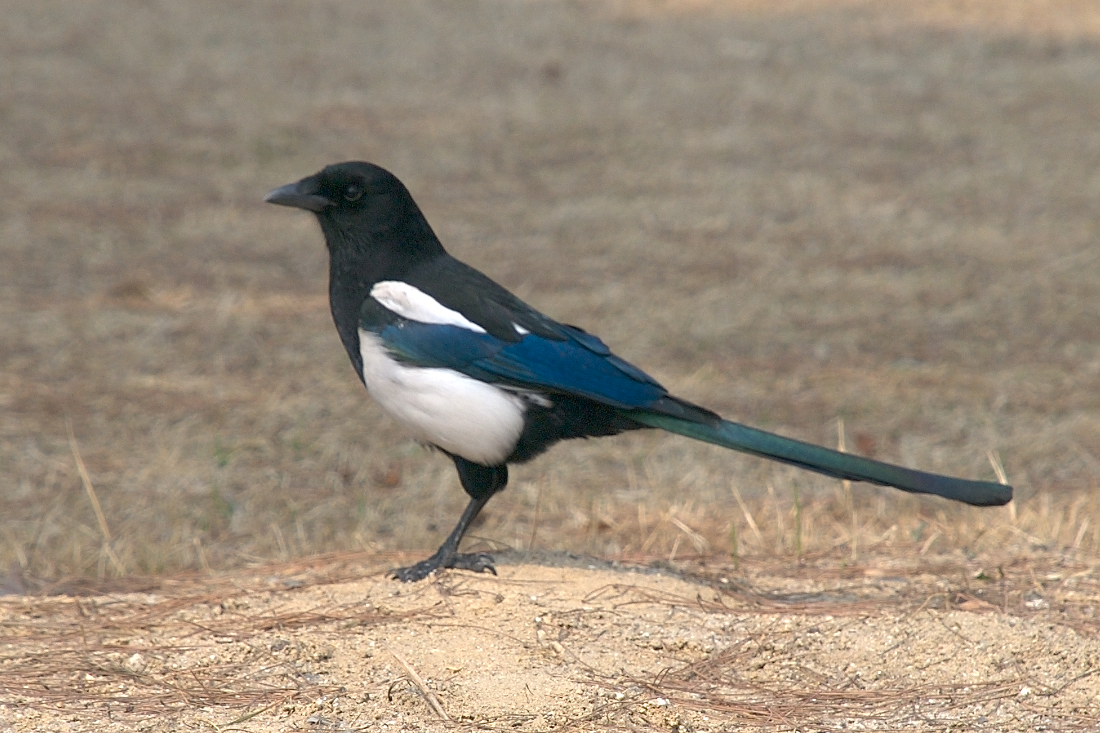
Bangladesh
National Animal
Royal Bengal Tiger

Slide 8
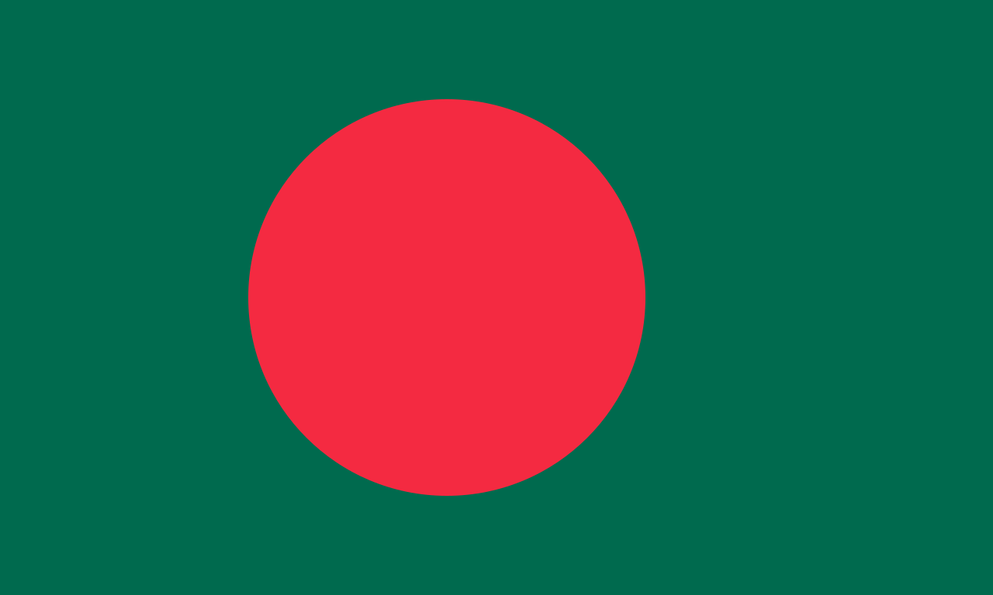
Bangladesh
National Mosque
Baitul Mukarram

Slide 9
Bangladesh
National Fish
Hilsha Fish

Slide 10
Bangladesh
National Bird
Magpie

Slide 11
Bangladesh
National Flag
Green With Red Circle

